Slide 1
Instructions
Select the image you want to use
Replace the text in English with the text in your local language and adjust the size of the font if necessary.
Once complete, select File--> Save as in the PowerPoint menu.
Save the slide as a JPG.
PowerPoint will ask "Which slides do you want to export?"
Select "Just This One„
Post on your social media profiles and don´t forget to use #FHAwarenessDay and tag @FH Europe Foundation.
Thank you
for helping us spread awareness about FH!

Slide 2

High cholesterol can be inherited.
#PreventThePreventable
Learn about Familial Hypercholesterolaemia (FH) to save lives.

Slide 3

It is estimated that Familial Hypercholesterolaemia (FH) affects over 30 million people globally.
But only 10% of them know this.

Slide 4

It is estimated that Familial Hypercholesterolaemia (FH) affects over 30 million people globally.
But only 10% of them know this.

Slide 5
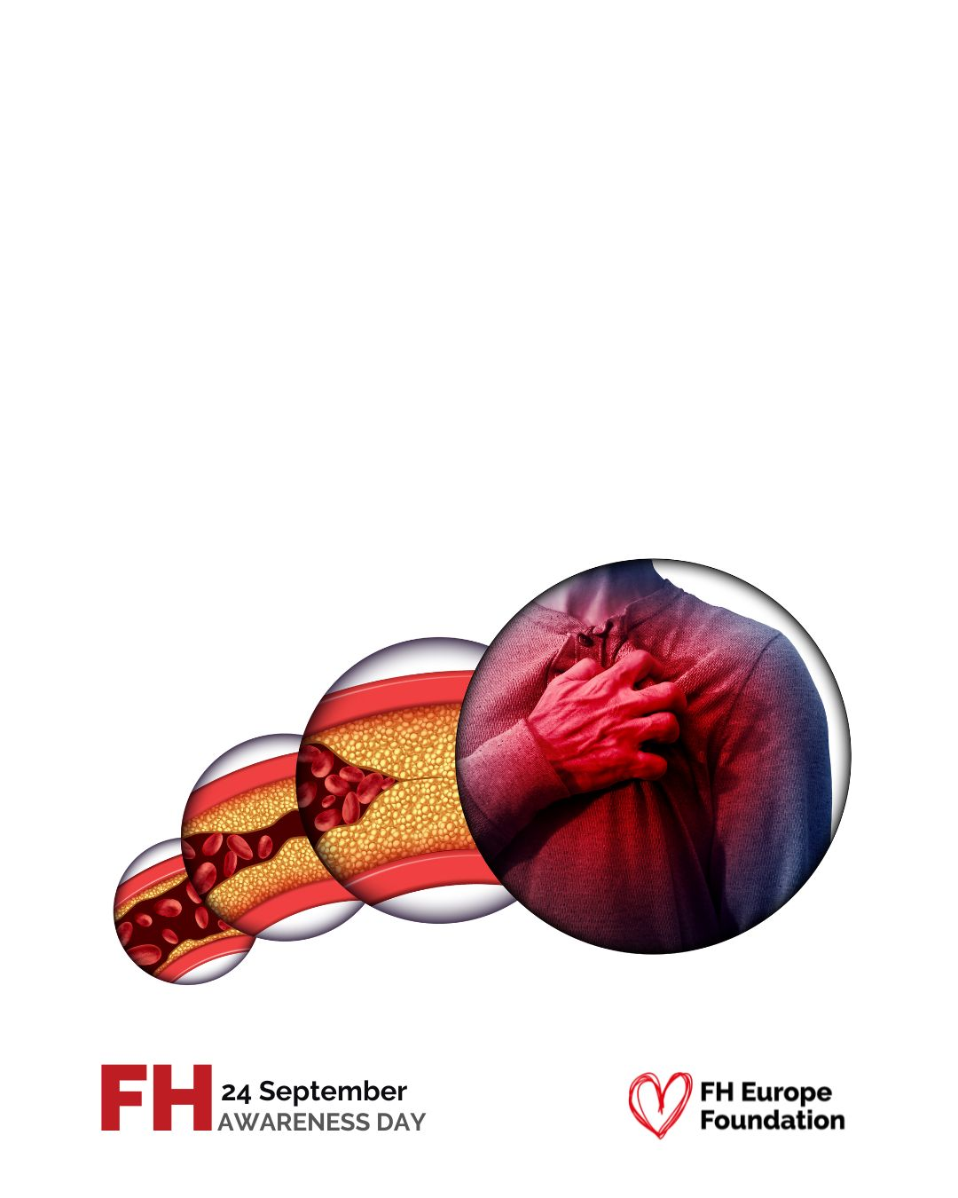
FH leads to atherosclerosis.
Atherosclerosis is the thickening (narrowing) of the arteries, which reduces blood supply to the heart.

Slide 6

Familial Hypercholesterolaemia (FH) means high LDL cholesterol running in the family.

Slide 7

Undetected and unmanaged FH leads to early atherosclerosis, heart attacks, even premature death.

Slide 8
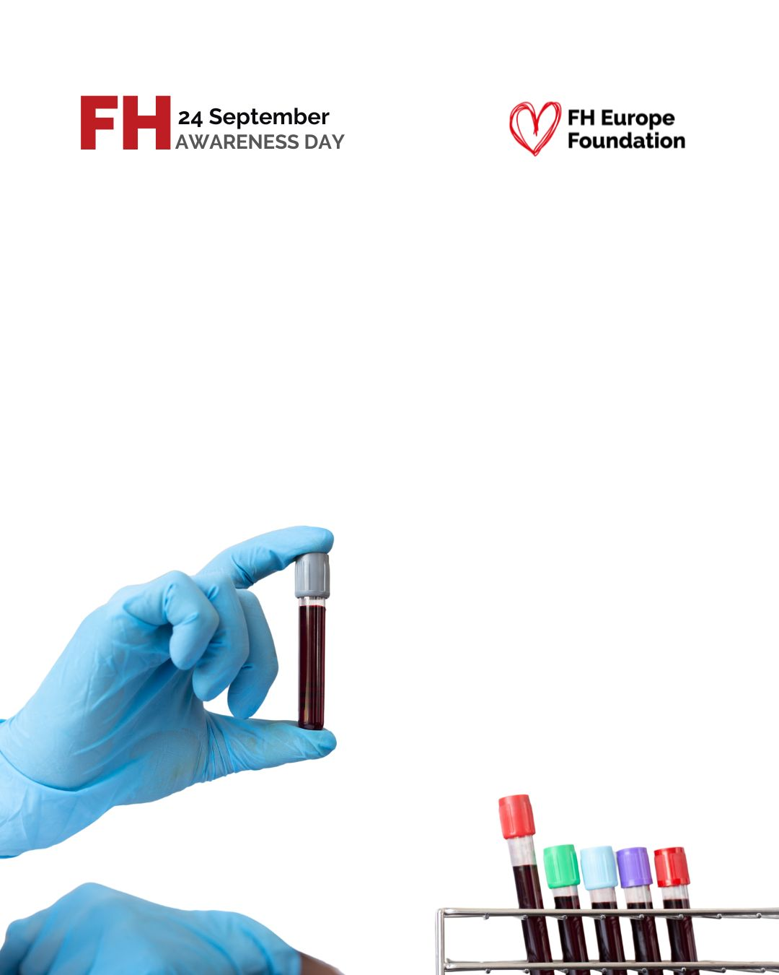
A simple blood test plus a family health history can help detect FH.

Slide 9

Every minute somewhere in the world a baby with Familial Hypercholesterolaemia (FH)
is born.

Slide 10

Every minute somewhere in the world a baby with Familial Hypercholesterolaemia (FH)
is born.

Slide 11
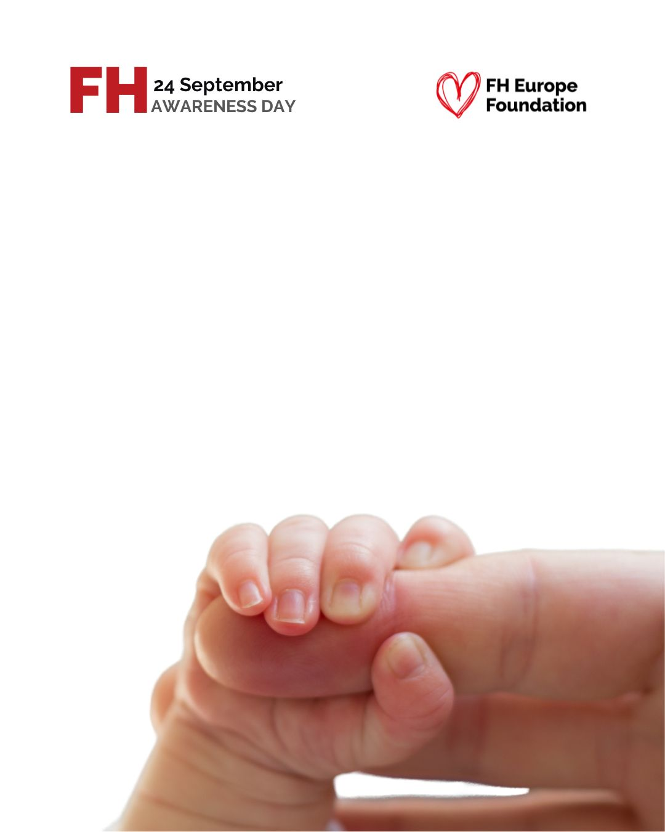
Every minute somewhere in the world a baby with Familial Hypercholesterolaemia (FH)
is born.

Slide 12

If you have FH, understanding your genetic lineage
is crucial.

Slide 13

Familial Hypercholesterolaemia (FH) means very high cholesterol running in family.

Slide 14

Familial Hypercholesterolaemia (FH) means very high cholesterol running in family.

Slide 15

Familial Hypercholesterolaemia (FH) has two forms.
The heterozygous FH (HeFH) is common, while homozygous FH (HoFH) is rare and severe, critically affecting very young children.

Slide 16

Homozygous Familial Hypercholesterolaemia (HoFH) is a severe and rare form of FH.
It occurs when a child inherits the same gene from both parents with FH.

Slide 17
If both parents have Familial Hypercholesterolaemia (FH), there is a 25% chance that their child will have HoFH.

